Slide 1

Java Frameworks
Image Placeholder

Slide 2
Spring Framework
Image Placeholder

Slide 3
Spring Framework
Spring is a popular open-source application development framework that offers a wide range of features to simplify the development of enterprise-level applications. Some of the main features of the Spring framework include:
Testing
08
Dependency Injection
01
01
08
02
Transaction management
AOP
02
07
07
03
MVC
03
Data access
06
06
04
Integration with frameworks
05
04
Security
05

Slide 4
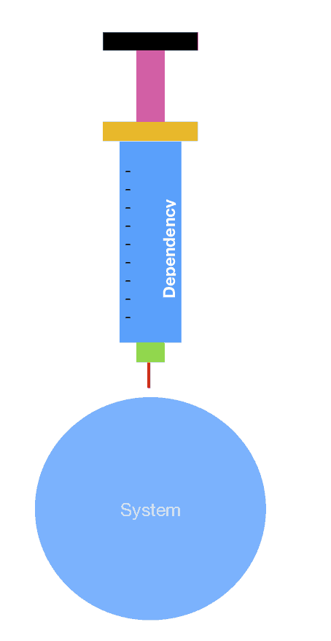
Dependency Injection
Spring provides a powerful dependency injection (DI) mechanism that allows you to manage the dependencies between your application components.
DI makes it easy to write loosely coupled code and helps you to keep your code modular and maintainable.

Slide 5
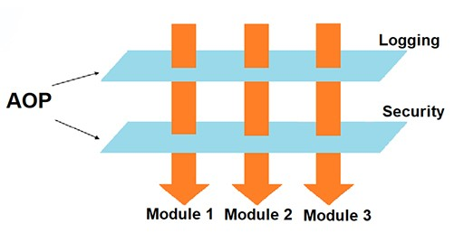
AOP
Spring offers a powerful AOP (Aspect-Oriented Programming) framework that allows you to separate cross-cutting concerns (e.g., logging, security, and caching) from the core business logic of your application.
This makes it easier to manage the complexity of your code and to reuse common functionality across your application.

Slide 6
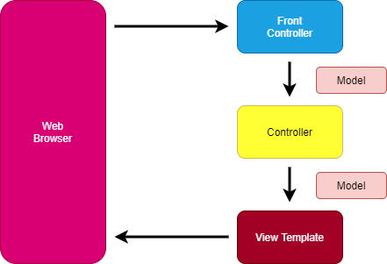
MVC
Spring's MVC (Model-View-Controller) framework provides a powerful and flexible architecture for building web applications.
The framework makes it easy to separate the concerns of your application, such as business logic, presentation logic, and data access, and provides a wide range of features for building robust and scalable web applications.

Slide 7
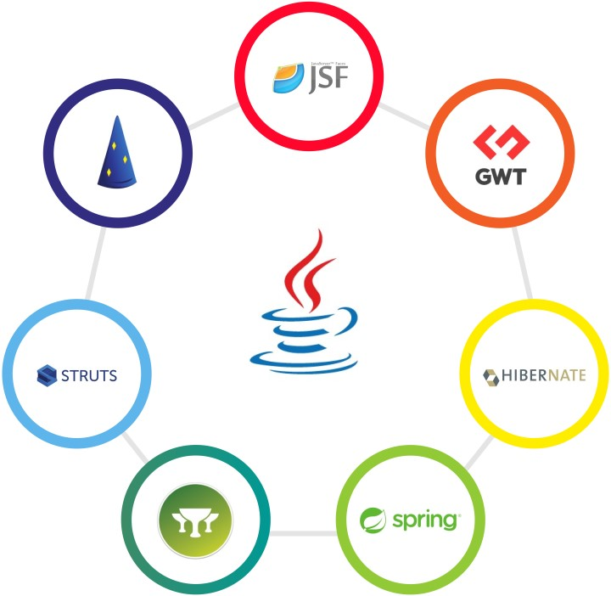
Integration with other Frameworks
Spring can be easily integrated with other popular Java frameworks such as Hibernate, Struts, and JSF, making it easy to build powerful and scalable applications using a combination of technologies.

Slide 8

Security
Spring provides a comprehensive security framework that allows you to secure your applications using a variety of techniques such as authentication, authorization, and encryption.

Slide 9
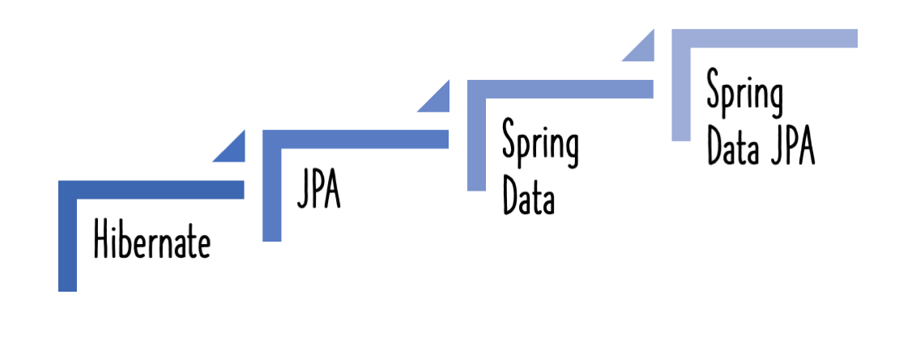
Data access
Spring provides a powerful data access framework that supports a wide range of data sources and databases, including JDBC, JPA, and Hibernate.

Slide 10
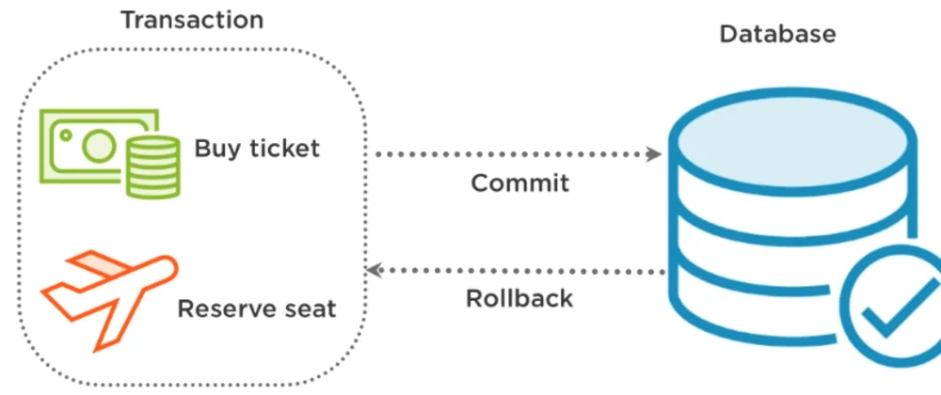
Transaction management
Spring provides a powerful transaction management framework that supports both declarative and programmatic transaction management.

Slide 11
Testing
Spring provides a comprehensive testing framework that makes it easy to write unit tests for your applications and to integrate your tests with popular testing frameworks such as JUnit.
Overall, the Spring framework provides a comprehensive set of features for building enterprise-level applications. Its modular design, flexibility, and ease of use make it a popular choice among developers for building robust and scalable applications.

Slide 12
Spring vs Spring Boot
Image Placeholder

Slide 13
Spring vs Spring Boot
Configuration
Dependencies
Auto-configuration
Microservices
Standalone application
Spring and Spring Boot are two popular Java frameworks, and while they share some similarities, there are also some key differences between them.

Slide 14
Configuration
One of the main differences between Spring and Spring Boot is their configuration approach.
In Spring, you typically configure your application using XML or Java-based configuration files, which can be complex and time-consuming.
In contrast, Spring Boot is designed to be opinionated and makes use of a "convention over configuration" approach, which means that you can quickly set up and configure your application with minimal effort.

Slide 15
Dependencies
Another difference between Spring and Spring Boot is the way they handle dependencies.
Spring requires you to manage your own dependencies and to configure your application's classpath manually.
In contrast, Spring Boot comes with a set of pre-configured dependencies and provides a dependency management system that allows you to easily manage and resolve dependencies in your application.

Slide 16
Auto-configuration
Spring Boot also provides auto-configuration, which means that it can automatically configure your application based on the dependencies that are present on your classpath.
This can save you a lot of time and effort and makes it easy to get started with Spring Boot.

Slide 17
Microservices
Spring Boot is often used for building microservices, which are small, independent services that work together to form a larger application.
Spring Boot provides a number of features that are specifically designed for building microservices, such as embedded web servers and support for cloud-based deployment platforms like Kubernetes.

Slide 18
Standalone Application
Spring Boot is designed to be a standalone application, which means that it can be run on its own without requiring any additional infrastructure.
This makes it ideal for building self-contained applications that can be easily deployed and run on a variety of platforms.
Overall, while Spring and Spring Boot share some similarities, Spring Boot is designed to be a more opinionated and streamlined framework that makes it easy to get started with Spring-based development and to build modern, cloud-native applications.

Slide 19
Hibernate
Image Placeholder

Slide 20
Hibernate
Object-Relational Mapping
Database Independence
Lazy Loading
Caching
Transactions
Query Language
Integration with other frameworks
Hibernate is a popular open-source ORM (Object-Relational Mapping) framework that allows you to map Java objects to database tables, and vice versa.
Some of the main features of Hibernate framework include:

Slide 21
Object-Relational Mapping
Hibernate provides a powerful ORM framework that allows you to map Java classes and objects to database tables and columns, and vice versa. This makes it easy to work with databases using object-oriented programming techniques and eliminates the need for writing complex SQL queries.

Slide 22
Database Independence
Hibernate provides database independence by abstracting the underlying database details from the application code.
This means that you can write database agnostic code that can work with any database without worrying about the differences in the SQL syntax.

Slide 23
Lazy Loading
Hibernate provides support for lazy loading, which means that it loads data from the database only when it is required.
This can improve performance by reducing the amount of data that needs to be loaded into memory.

Slide 24
Caching
Hibernate provides support for caching, which can improve the performance of database operations by reducing the number of database calls.
Hibernate supports both first-level caching and second-level caching.

Slide 25
Transactions
Hibernate provides transaction management support, which allows you to perform database operations as a single, atomic unit of work.
This ensures that either all or none of the operations in a transaction are completed, maintaining data consistency.

Slide 26
Query Language
Hibernate provides its own query language called Hibernate Query Language (HQL), which is similar to SQL but is object-oriented.
HQL allows you to write queries that work with objects instead of database tables.

Slide 27
Integration with other Frameworks
Hibernate can be easily integrated with other popular Java frameworks such as Spring, Struts, and JSF, making it easy to build powerful and scalable applications using a combination of technologies.
Overall, Hibernate is a powerful ORM framework that provides a wide range of features for simplifying database operations in Java-based applications. Its database independence, lazy loading, caching, transaction management, and query language support make it a popular choice among developers for building enterprise-level applications.

Slide 28
JPA (Java Persistence API)
Image Placeholder

Slide 29
JPA (Java Persistence API)
Object-Relational Mapping
Database Independence
Lazy Loading
Caching
Transactions
Query Language
Integration with other frameworks
JPA (Java Persistence API) is a Java EE specification that provides a set of interfaces and annotations for persisting Java objects to a relational database.
Some of the main features of JPA include:

Slide 30
Object-Relational Mapping
JPA provides an ORM (Object-Relational Mapping) framework that allows you to map Java classes and objects to database tables and columns, and vice versa.
This makes it easy to work with databases using object-oriented programming techniques and eliminates the need for writing complex SQL queries.

Slide 31
Database Independence
JPA provides database independence by abstracting the underlying database details from the application code.
This means that you can write database agnostic code that can work with any database without worrying about the differences in the SQL syntax.

Slide 32
Lazy Loading
JPA provides support for lazy loading, which means that it loads data from the database only when it is required.
This can improve performance by reducing the amount of data that needs to be loaded into memory.

Slide 33
Caching
JPA provides support for caching, which can improve the performance of database operations by reducing the number of database calls.
JPA supports both first-level caching and second-level caching.

Slide 34
Transactions
JPA provides transaction management support, which allows you to perform database operations as a single, atomic unit of work.
This ensures that either all or none of the operations in a transaction are completed, maintaining data consistency.

Slide 35
Query Language
JPA provides its own query language called JPQL (Java Persistence Query Language), which is similar to SQL but is object-oriented.
JPQL allows you to write queries that work with objects instead of database tables.

Slide 36
Integration with other Frameworks
JPA can be easily integrated with other popular Java frameworks such as Spring, Struts, and JSF, making it easy to build powerful and scalable applications using a combination of technologies.
Overall, JPA is a powerful ORM framework that provides a wide range of features for simplifying database operations in Java-based applications. Its database independence, lazy loading, caching, transaction management, and query language support make it a popular choice among developers for building enterprise-level applications.

Slide 37
Thank You
Image Placeholder

